Slide 1
The 4 Components of EPICS in Career Decision making
by Karen E Anderson
Notes:
Hello and welcome to EPICS, the Environment and Personality Intuitive Card Sort. This is a quick overview on how to use all the different components of the program.
EPICS is based on the Holland themes and visual literacy to elicit responses when making career decisions. These themes are divided into two categories personality and environment.
It is our mission to have participants think about what is important to them, such as values, work conditions, advancement, and security, for having a meaningful career and realistic goals.

Slide 2
The Holland Themes
Notes:
These are the Holland themes and after you take the EPICS assessment, the results are computed in theme dominancy.
Normally the top most dominant themes are refered to as the Holland code and are designated by the using the acryonuim RIASEC

Slide 3
EPICS assessment
Assessment
(Intuition)
What we know to be true about our self
Likes & Dislikes
Strengths & Weaknesses
How one communicates with others
Environments one is comfortable in and can thrive in
Notes:
The EPICS assessment uses past experiences, emotion and interests to assess one’s dominant themes in both personality and environment.
Commonly the themes appear in both categories but not always in the same dominancy. For example, a person’s result may be E,C,S for Personality but have C,A,S for Environment. This would tell you that their personality is organized, they like to persuade others toward a common idea/topic/concern and easily communicate these ideas. And they would best thrive in an environment that was structured, that uses ideas that are out-of-the-box perhaps and in social settings such as events, trainings, presentations.
Using the worksheets and activities provided will help to peel back layers in each theme to understand the person’s particular code better.

Slide 4
The 4 Components
EPICS Assessment
Right-Brain
Left-Brain
Personalized Strategy
ACTIVITIES
Notes:
The EPICS program is intended to be self-directed. The flow of strategy is to build on using the results of the assessment, and then engaging both sides of the brain in the decision-making process utilizing worksheets provided.
The participant will first take the assessment. This will engage the unconscious and intuition by getting their creative juices flowing in responses to the imagery. Then by using the worksheets, they can begin to focus on what their values are, which work conditions are important to them and get a realistic snapshot of the type of career they are searching for.
The worksheets and activities are designed to use both sides of the brain by being visually stimulating while engaging the cognitive side to select and prioritize their responses.
Once they have some concrete answers, a personal strategy can be developed.

Slide 5
A picture is worth a thousand words
Assessment
Notes:
So what does this image evoke, mean or suggest to you?
What memories, expectations, emotions do you associate with it?
This is the type of reaction or response the card sort is to have on a participant.

Slide 6
Right brain
Strategy
(Creative )
Visually engages the psyche
Provides motivation
Intentional art making
Vision Boards
Guided Visualizations
Notes:
83% of all learning is visual.
Vision boards and guided visualizations work on the gut level in response to emotions, likes, dislikes and personal strengths…
Intentional art making will help values and desired work conditions surface in a concrete way.

Slide 7
Right brain
Strategy
(Creative )
Notes:
When we create images that have meaning, it gives us a concrete and real object to work with, which in turn can become a goal to strive for and not just an idea.
These images evoke emotions and each individual will response differently.
Because of this, it is important to not judge or make assumptions about a individual’s art before they have an opportunity to explain it to you.

Slide 8
Left brain
Strategy
(Decision making)
Work sheets
Assessments
Career planning
Notes:
The thinking side of the brain will help make sense of everything elicited by the creative side.
Concrete answers can be formed from the abstract aspect of the visual and emotional responses.
The work sheets are designed to help connect the dots for those who might need a little guidance in prioritizing what is important to them.

Slide 9
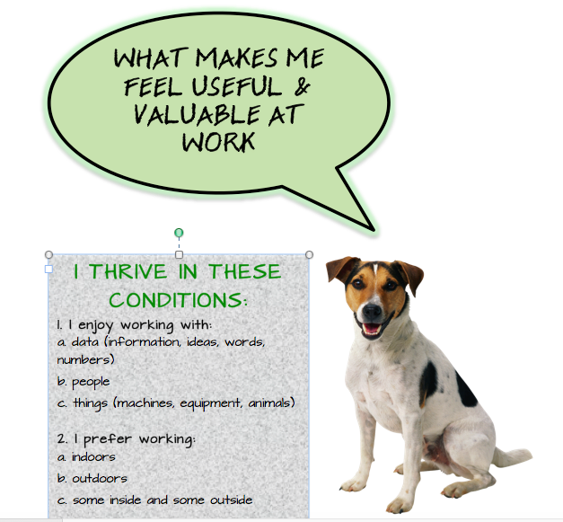
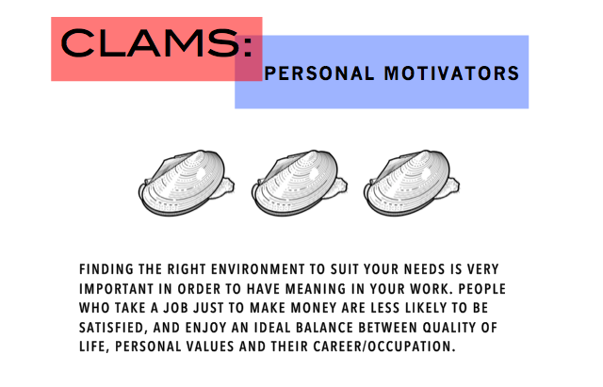
Left brain
Strategy
(Decision making)
Examples of worksheets
Notes:
The worksheets can be printed to help the participants understand and prioritize what is valuable and meaningful in their life which directly correlates to their career.
The average person works 92,000 hours in their lifetime. That is why meeting their values in a work environment is needed to be successful.
The following video will explain how to use these handout, either as homework, in group setting or in a one-on-one session.

Slide 10
Explanation of results and work sheets
Strategy
This video shows you how to use the worksheets like CLAMS, values and other activities.
Go to the link below for a videos on Using EPICS Effectively
https://youtu.be/UO_kYFgZnh4

Slide 11
How to make a vision board
Strategy
There are many videos on YOUTUBE that you can watch on how to make a vision board. I like to use sticky notes when I am working with someone.
Go to the link below for a videos on making a vision board.
https://youtu.be/eHWszh4HeBo

Slide 12
Additional videos… There are videos that briefly describe each of the six themes as to personality and environment on www.epicscareer.com
Notes:
If you go to media page on epics career finder, there are fun and engaging videos that explain the different themes.

Slide 13
Help the participant understand why values, and work conditions are so important to a meaningful and successful work life. Keep it simple.
Strategy
Notes:
I have found that at every phase in life , we can always check in to see how we are feeling whether it is at work, home or social environments we live in.
For many young adults, personal values and work conditions it is not the first thing they may consider when looking for a job or career. Money, internship, status or what someone said they would be good at a or have a skill, might be the reason they go down a particular path.
If they become unhappy or unsuccessful, it could be because of the environment isn’t a good fit, they express themselves differently or because some of their personal values are not being met.
Sometimes I have found by peeling back the layers and getting to the basics is a good way to start.

Slide 14
Email: Karen Anderson karen@epicscareer.com
Any questions?
Notes:
Thank you for taking the time to watch this power point, and I hope it has clarified how to use EPICS. Feel free to email me with an questions or concerns you may have.

