Slide 1
Using Visual Literacy to Engage Individuals in Career Choice
Karen Anderson MA, ATR-BC
2017 CT Secondary Transition Symposium
Wednesday, June 21st
Notes:
This template is in widescreen format and demonstrates how transitions, animations, and multimedia choreography can be used to enrich a presentation.
----- Meeting Notes (6/5/17 19:33) -----
Hello and welcome to EPICS Career Finder
EPICS is an online assessment which offers different programs.

Slide 2
EPICS: Career Finder
Environment and Personality Intuitive Card Sort (EPICS)
Individual, Licensed & Certification Programs
EPICS is an assessment made of images in which you simply respond by saying if you find images interesting or not.
It's easy, non-threatening, and universal.
EPICS has been used by life coaches and counselors, in schools and a prison, all to help individuals seeking a change.
Notes:
This slide can be used as a background before the presentation begins.
----- Meeting Notes (6/5/17 19:33) -----
It is an assessment made of images in which you simple reponed by saying you like it and find it interesting or not.
It's easy, non-threatening and universal.
EPICS has been used in schools, by life coaches and counselors, a prison as well as by individuals seeking a change.

Slide 3
Components That Shape Our Career Choices
Past Experience
Emotional Links
Likes & Dislikes
These are some of the elements we access in career development. These are essential to understand if we want to have a meaningful career.
Notes:
These are some of the elements we access in career development. These are essential to understand if we want to have a meaningful career.

Slide 4
Discovering the perfect fit career choice
Cognition
Self-Discovery
Intuition
Using
Assessments
Activities
There are different pathways to career development, all depending on the individual and how they feel comfortable expressing themselves.
Notes:
There are different pathways to career development. It depends on each individual and how they feel comfortable expressing themselves.

Slide 5
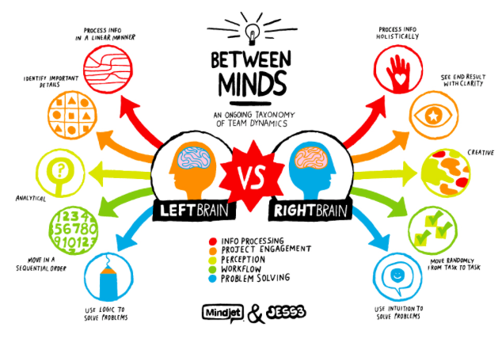
Assessment & Activities
Assessments
Surveys
Holland codes
Writing Reading
Following instructions
EPICS
Vision boards
Guided Visualizations
Journaling
Intentional Art Making
Creating
Our left side of the brain controls cognition (reading, answering questions, acquiring knowledge). The right side uses intuition - having immediate understanding without conscious reasoning (“our gut instinct”).
Using a visual assessment springboards career development by sparking interests that can then be followed up with both intuitive and cognitive activities.
Notes:
Our left side of the brain is where all the cognitive activity takes place, reading, answering questions, acquiring knowledge. The right side uses intuition, having immediate understanding without onscious reasoning- our gut instinct.
Using a visual assessment to engage individuals can serve as a springboard for investigating career development. It sparks interests that can be followed up with both intuitive and cognitive activities.

Slide 6
The Synergy of Intuition & Cognition For a Career Exploration and Discovery
.
Using our intuition to identify our likes and dislikes
Understanding the best environment in which to thrive.
Effectively communicating by understanding our personality
When our right and left sides of the brain work together, we can move forward and make decisions with the confident realization of how and where we fit in best.
Notes:
When our right and left sides of the brain work together.
We can make congruent and authentic choices,
moving forward with confident realization of what and where we fit in best.

Slide 7
We are Committed to Improving The EPICS’ Experience
EPICS acknowledges the fact that today 60%-80% of learning is through visual technology, bringing visual literacy to the forefront.
We would like to invite other groups to be forerunners by addressing and implementing visual literacy learning, and offer a 6 month trial offer to use with each of these populations:
ESL
At-risk students
Individuals in transition
Special Education
Displaced workers
Please email to learn more – karen@epicscareer.com
Notes:
EPICS acknowledges the fact that today 60%-80% of learning is through visual technology, bringing visual literacy to the forefront.
Using EPICS can help serve a broader group and a diversified population.
We would like to invite other groups to be a forerunner by addressing and implementing visual literacy learning.
To bring about this change, EPICS would like to offer a one 6 month trial offer to use with each of these populations: Please email us to be considered for a trial offer.

Slide 8
Thank you for your time and watching today! We hope to see you at the 2017 Connecticut Secondary Transition Symposium
Notes:
Thank you for your time and watching today! We hope to see you at the 2017 Connecticut Secondary Transition symposium

